Slide 1
Data Visualization of Crop Production Analysis

Slide 2
Objective:
Analysis of the India Crop Production

Slide 3
Structure of DataSet
Sample file name (crop_production)
Number of rows - 7
Number of Columns - 246091

Slide 4
Architecture
Collect data
Data Validation
Data Transformation
Result
Export data to Tableau

Slide 5
Introduction
Our Indian Crop Analysis Prediction project aims to revolutionize agriculture by leveraging advanced data analytics and machine learning techniques. By analyzing extensive data sets related to crop yields, weather patterns, soil composition, and market trends, we seek to develop accurate predictions for crop productivity and identify potential risks and opportunities. This project will empower farmers and policymakers with actionable insights to make informed decisions, optimize resource allocation, mitigate crop failures, and maximize agricultural output. By harnessing the power of technology, we strive to enhance food security, improve livelihoods, and drive sustainable growth in India's agricultural sector..

Slide 6
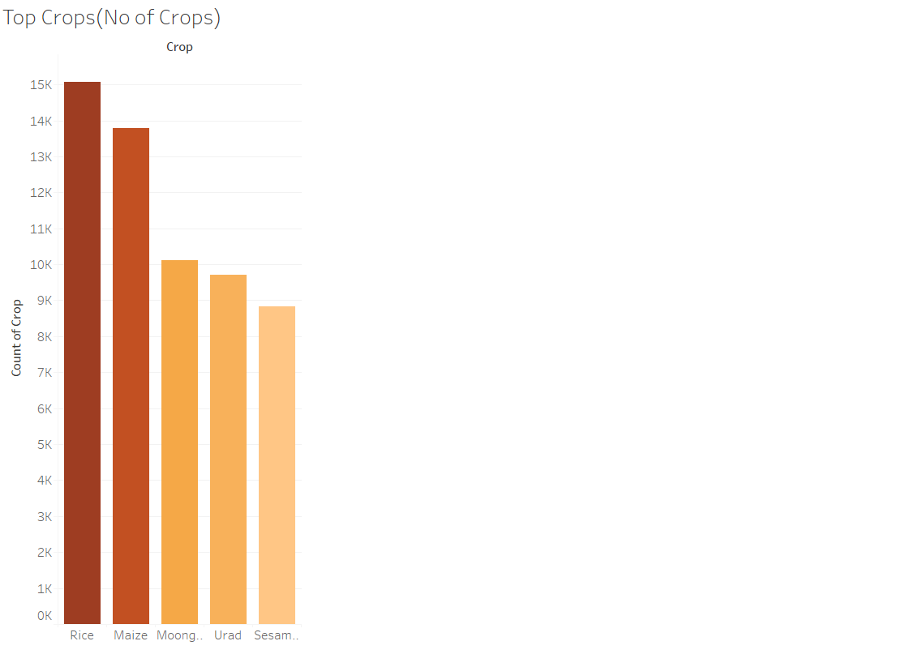
Top crops

Slide 7
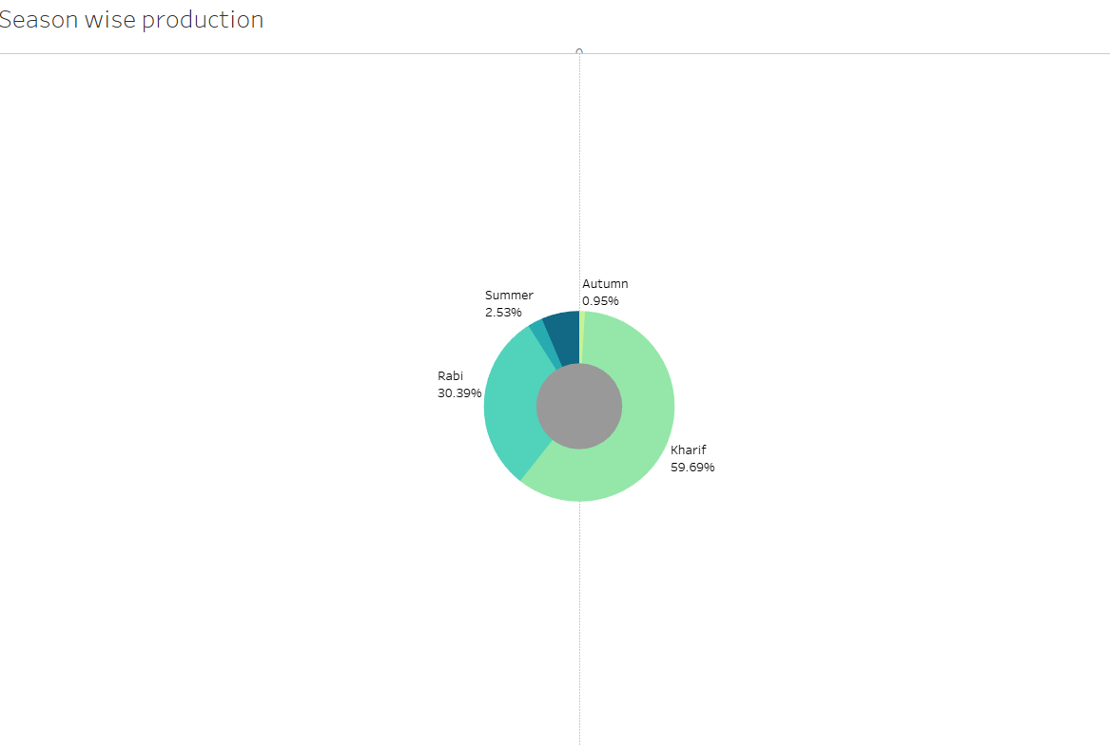
Season wise production

Slide 8
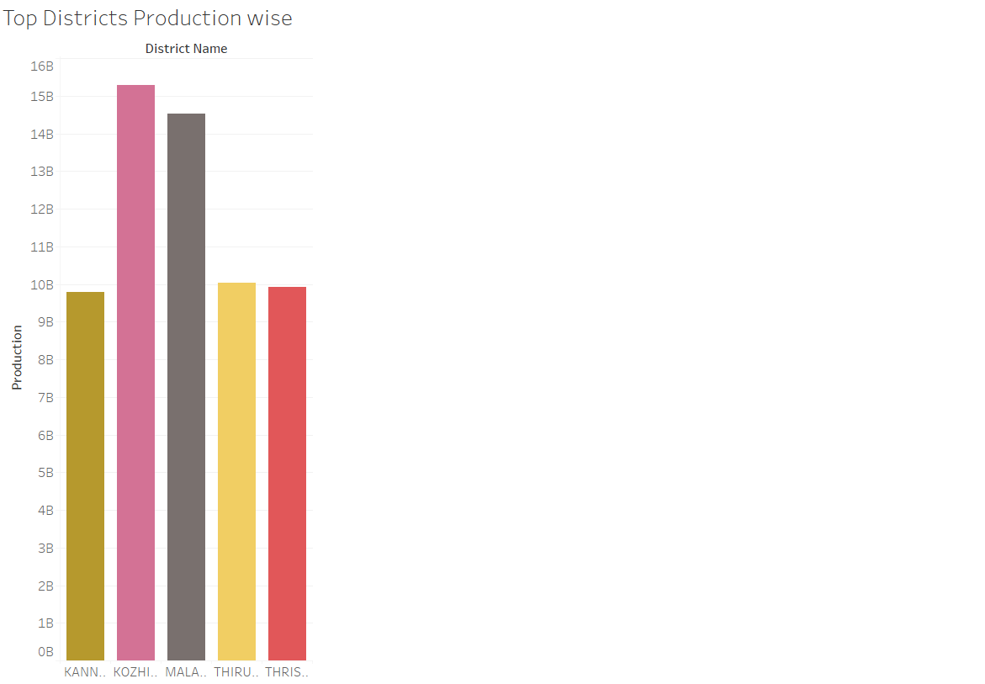
Top districts production wise

Slide 9
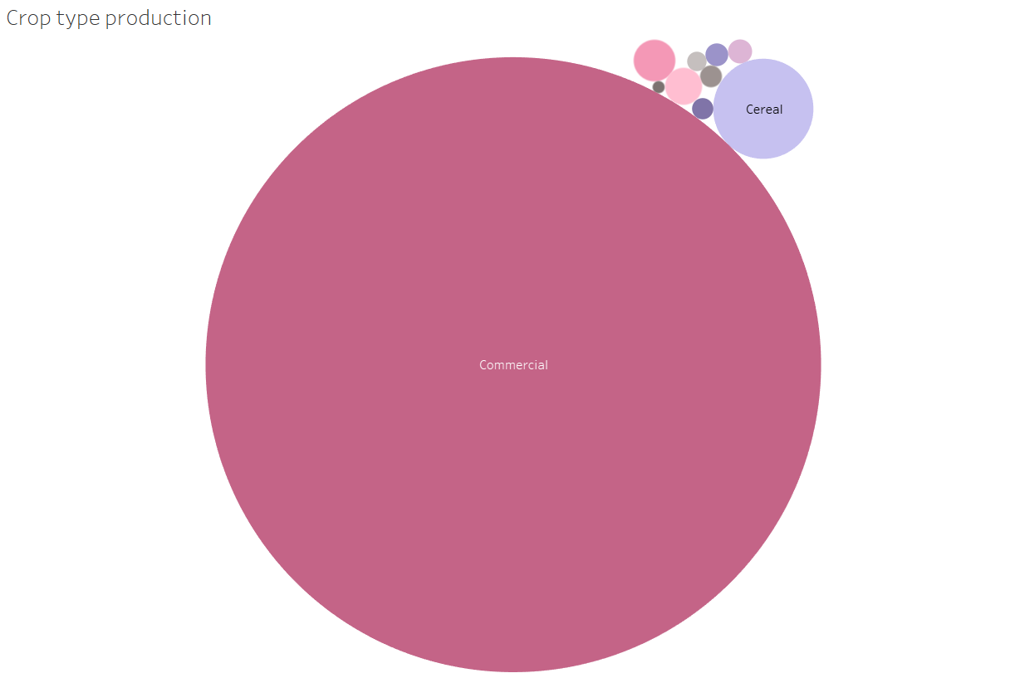
Crop type production

Slide 10
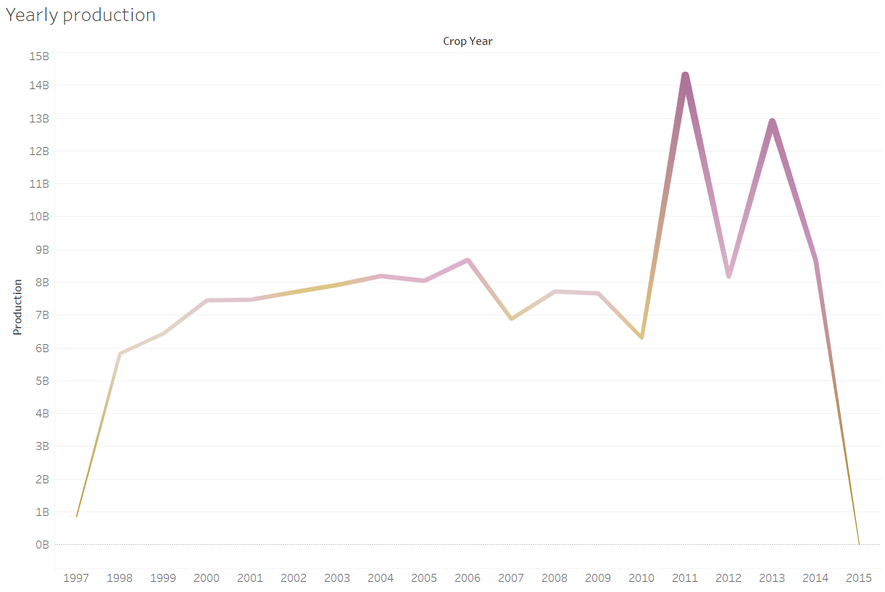
Yearly production

Slide 11
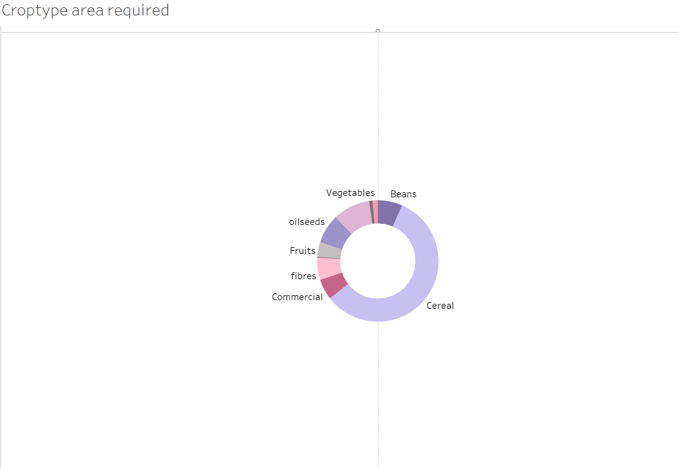
Croptype area required

Slide 12
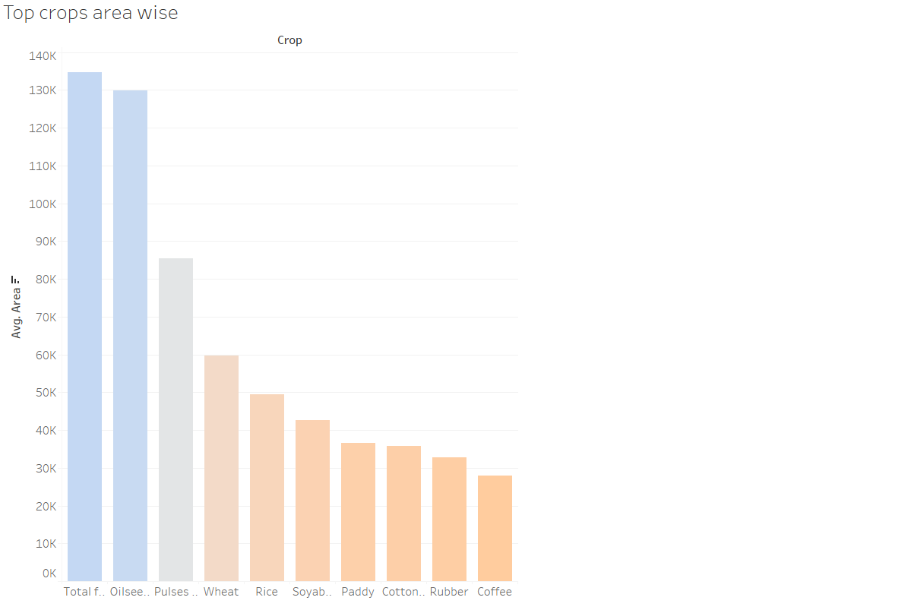
Top crops area wise

Slide 13
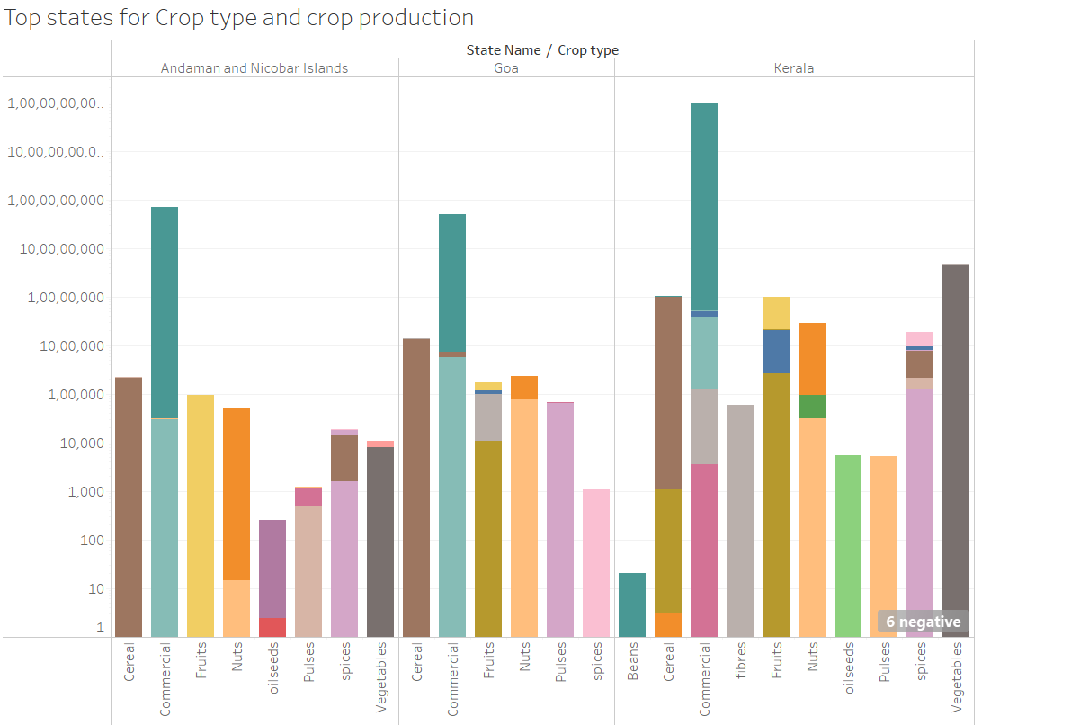
Top states for crop production and type

Slide 14
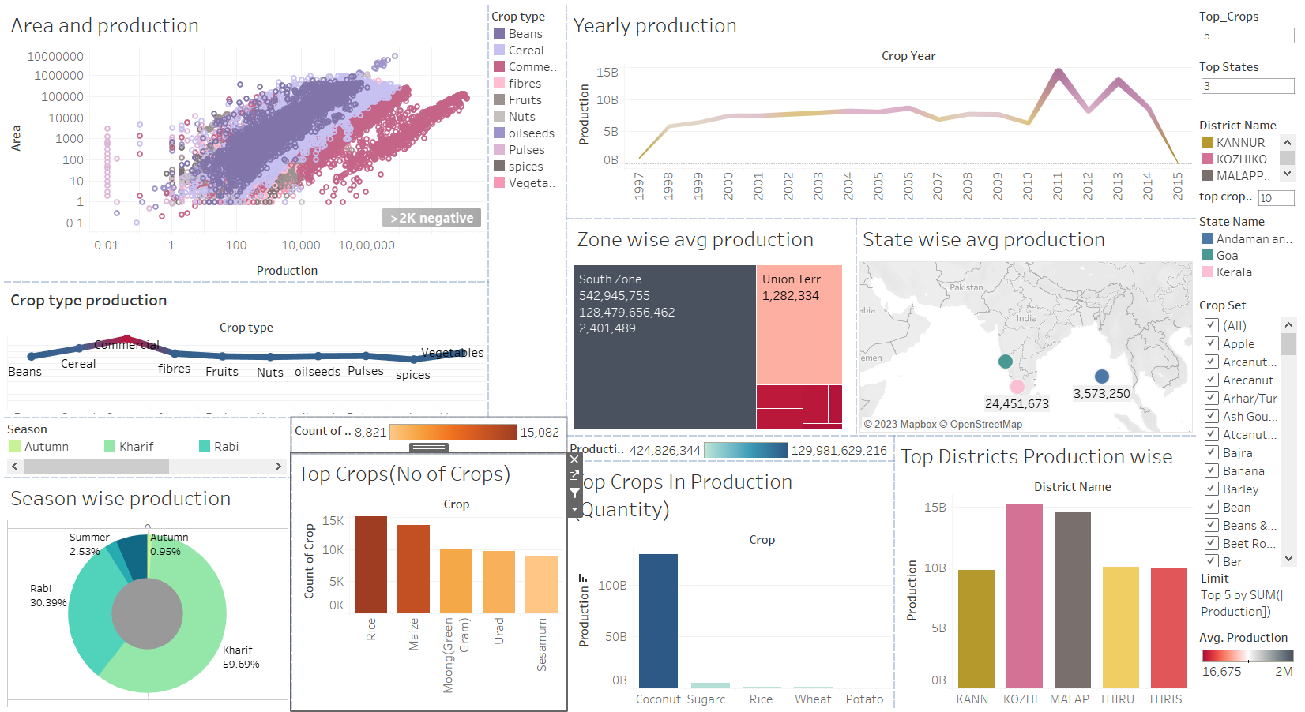
Analysis of crop production

Slide 15
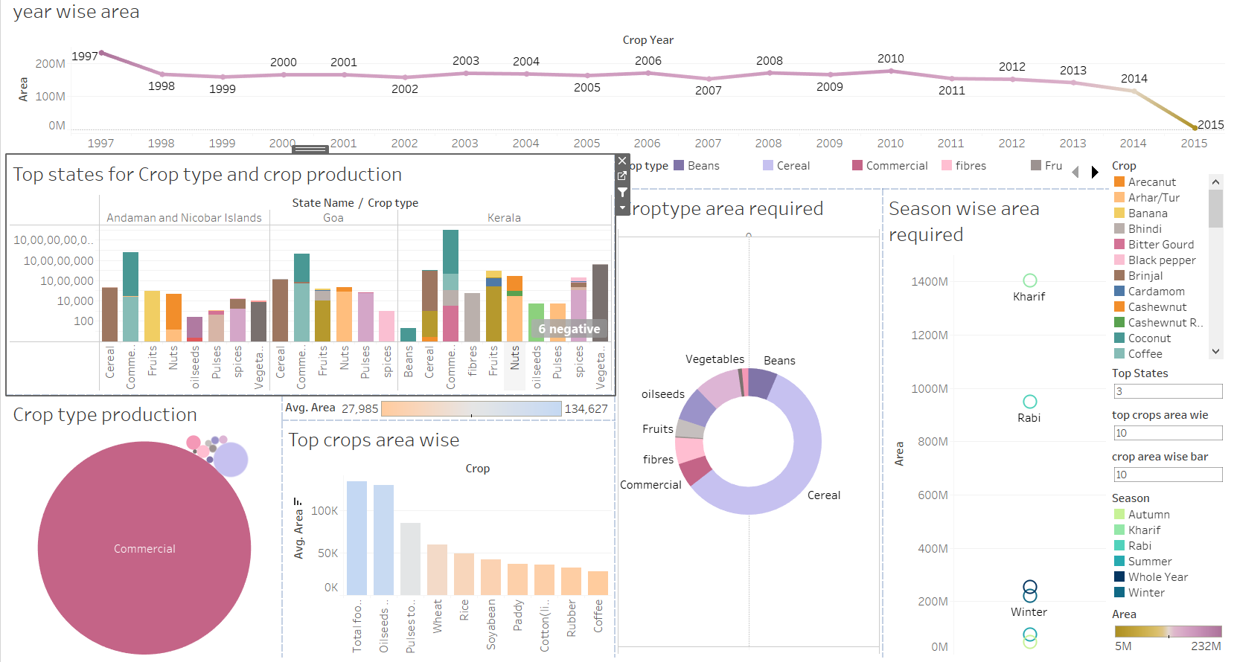
Analysis

